Slide 1
Time Series Analysis
Basics of Time Series Analysis
Nicoleta Serban, Ph.D.
Associate Professor
Stewart School of Industrial and Systems Engineering
Trend Estimation: Data Example

Slide 2
About this lesson

Slide 3
Data Example: Temperature in Atlanta, Georgia
Data: Average monthly temperature records starting in 1879 until 2016.
Available from the iWearherNet.com
The Weather Bureau (now the National Weather Service) began keeping weather records for Atlanta for 138 years since October 1, 1878.
Provided in Fahrenheit degrees
Do we find an increasing trend in temperature in Atlanta?

Slide 4
Data Example in R
## Time Series Plot
data = read.table("AvTempAtlanta.txt",header=T)
names(data)
[1] "Year" "Jan" "Feb" "Mar" "Apr" "May" "Jun" "Jul" "Aug" "Sep"
[11] "Oct" "Nov" "Dec" "Annual"
temp = as.vector(t(data[,-c(1,14)]))
temp = ts(temp,start=1879,frequency=12)
ts.plot(temp, ylab="Temperature")

Slide 5
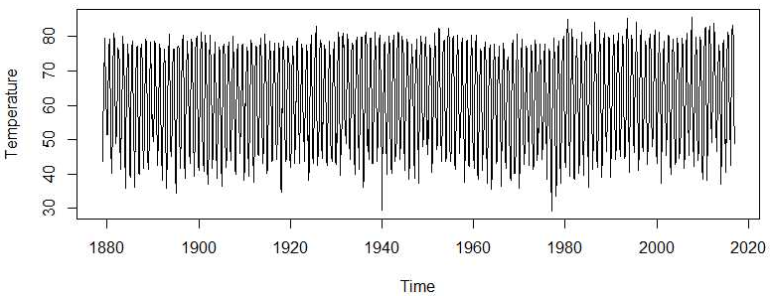
Data Example in R

Slide 6
Trend: Moving Average
## Create equally spaced time points for fitting trends
time.pts = c(1:length(temp))
time.pts = c(time.pts - min(time.pts))/max(time.pts)
## Fit a moving average
mav.fit = ksmooth(time.pts, temp, kernel = "box")
temp.fit.mav = ts(mav.fit$y,start=1902,frequency=12)
## Is there a trend?
ts.plot(temp,ylab="Temperature")
lines(temp.fit.mav,lwd=2,col="purple")
abline(temp.fit.mav[1],0,lwd=2,col="blue")

Slide 7
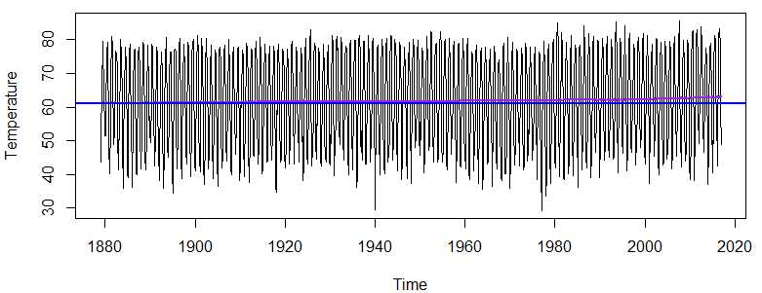
Trend: Moving Average

Slide 8
Trend: Parametric Regression
## Fit a parametric quadratic polynomial
x1 = time.pts
x2 = time.pts^2
lm.fit = lm(temp~x1+x2)
summary(lm.fit)
Estimate Std. Error t value Pr(>|t|)
(Intercept) 61.4247 0.9841 62.420 <2e-16 ***
x1 -1.5723 4.5481 -0.346 0.730
x2 3.4937 4.4062 0.793 0.428
## Is there a trend?
temp.fit.lm = ts(fitted(lm.fit),start=1879,frequency=12)
ts.plot(temp,ylab="Temperature")
lines(temp.fit.lm,lwd=2,col="green")
abline(temp.fit.lm[1],0,lwd=2,col="blue")

Slide 9
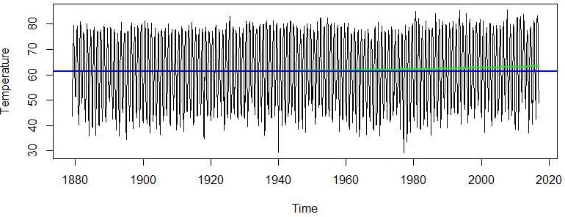
Trend: Parametric Regression

Slide 10
Trend: Non- Parametric Regression
## Local Polynomial Trend Estimation
loc.fit = loess(temp~time.pts)
temp.fit.loc = ts(fitted(loc.fit),start=1879,frequency=12)
## Splines Trend Estimation
library(mgcv)
gam.fit = gam(temp~s(time.pts))
temp.fit.gam = ts(fitted(gam.fit),start=1879,frequency=12)
## Is there a trend?
ts.plot(temp,ylab="Temperature")
lines(temp.fit.loc,lwd=2,col="brown")
lines(temp.fit.gam,lwd=2,col="red")
abline(temp.fit.loc[1],0,lwd=2,col="blue")

Slide 11
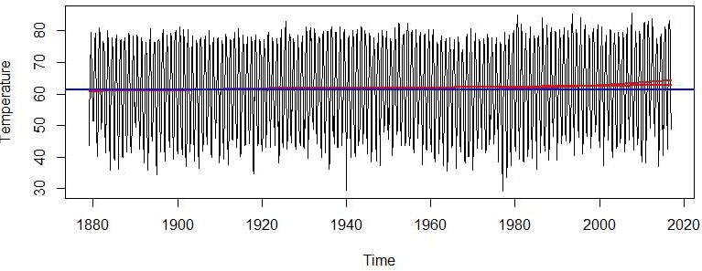
Trend: Non- Parametric Regression

Slide 12
Trend: Comparison
## Compare all estimated trends
all.val = c(temp.fit.mav,temp.fit.lm,temp.fit.gam,temp.fit.loc)
ylim= c(min(all.val),max(all.val))
ts.plot(temp.fit.lm,lwd=2,col="green",ylim=ylim,ylab="Temperature")
lines(temp.fit.mav,lwd=2,col="purple")
lines(temp.fit.gam,lwd=2,col="red")
lines(temp.fit.loc,lwd=2,col="brown")
legend(x=1900,y=64,legend=c("MAV","LM","GAM","LOESS"),lty = 1, col=c("purple","green","red","brown"))

Slide 13
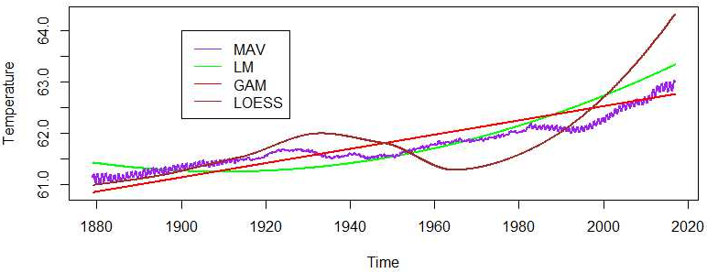
Trend: Comparison

Slide 14
Summary

